Slide 1
RESEARCH PRESENTATION
Dhaval Bhailalbhai Patel
[200439819]

Slide 2
PAPER 1
Audio Enhanced 3D Interfaces for Visually Impaired Users
Authors: Stephen W. Mereu, Rick Kazman
Department of Computer Science
University of Waterloo
Presented in 1996 at Proceedings of the SIGCHI Conference on Human Factors in Computing Systems
Funding:
Natural Sciences and Engineering Research Council of Canada, the University of Waterloo/Institute for Computer Research, and Intel Corporation

Slide 3
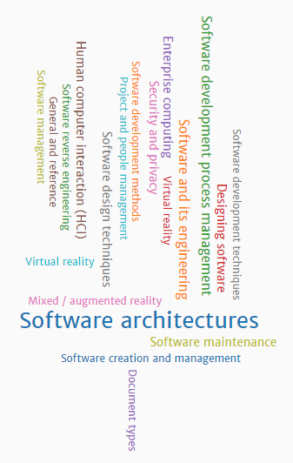
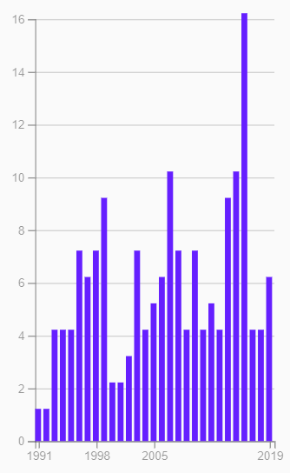
AUTHORS
RICK KAZMAN
PUBLISHED ITEM BY YEARS

Slide 4
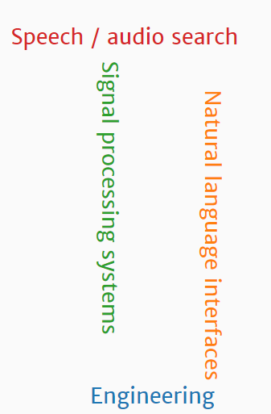
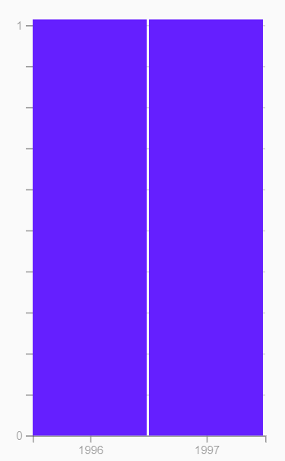
AUTHORS
Stephen W. Mereu
PUBLISHED ITEM BY YEARS

Slide 5
ABSTRACT
The central Idea of this research paper is to find out if we can successfully map audio to a 3D application thus increasing the depth perceptions for users .
The aim of this research paper are to
To prove that the audio feedback improves performance in 3d applications
Visually impaired users can use 3D application with accuracy of sighted users.
Visually impaired users perform better than sighted user in sound only conditions.
This research will help visually impaired users to access 3D applications.
Computer Human interactions Keywords
User Interface, Auditory Interface, Disability Access, 3D interface, sound as a metaphor in 3d applications

Slide 6
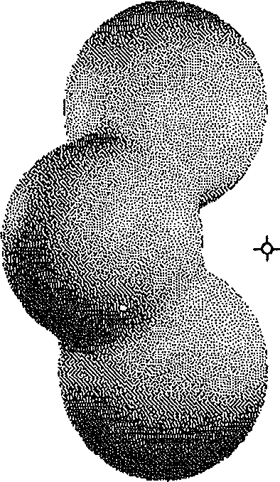
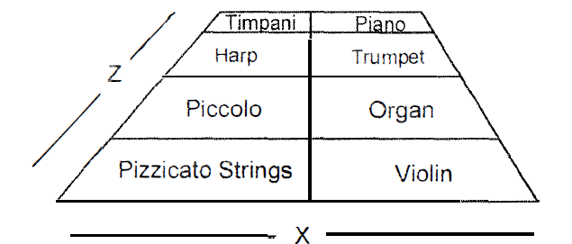
SETUP
Aim:
To move curser to the target placed on a randomly rotated blobby object.
Procedure:
Cursor movement was controlled using a standard mouse for the x and y directions and the up/down arrow keys for the z dimension. When reached at target user pressed space bar signalling task complete.
User’s Accuracy and time was recorded.
Testing was done with 4 types of sound environment:
[1] No sound Environment
[2] A sine wave tonal feedback
x to balance, y to pitch and z to volume.
[3] A musical environment that altered music being played for user
x (left/right) to balance (left/right), y (up/down) to pitch (high/low) and z (far/close) to volume (quiet/loud)
[4] orchestral environment that used an orchestral arrangement
x vs z[orchestral instruments] vs y [oscillations]

Slide 7
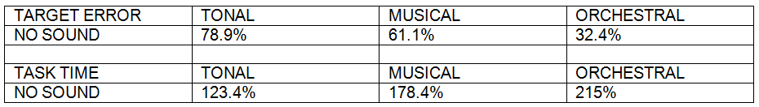
RESULTS
An ANOVA test is a way to find out if survey or experiment results are significant. In other words, they help you to figure out if you need to reject the null hypothesis or accept the alternate hypothesis.
SCENARIO 1: Twenty normally sighted subjects performed 25 trials on each of the four environments
This proved that sighted users were able to target object only with the aid of sound. So this study proves that we can use a sound environment in an applications where users need to focus elsewhere and for applications for visually impaired users.

Slide 8
RESULTS
SCENARIO 2: eight impaired subjects performed 25 trials on each of the four environments
.

Slide 9
RESULTS
SCENARIO 2: eight impaired subjects performed 25 trials on each of the four environments
sound environment vs subjective ratings
.

Slide 10
RESULTS
TARGET ERROR VS SOUND
Sighted users with Audio and Visual Clues performed better with less target time and less error. Whereas visually impaired users has only audio cues.
What is interesting is that although the visually impaired subjects took, on average, 4.3 times as long using the tonal environment, their accuracy (0.68 ) was comparable to the sighted user with the musical environment (0.67). This means that the tonal sound environment by itself is giving the visually impaired users as much information as the combination of visual and tonal cues gives a normally sighted user
.
TIME VS SOUND

Slide 11
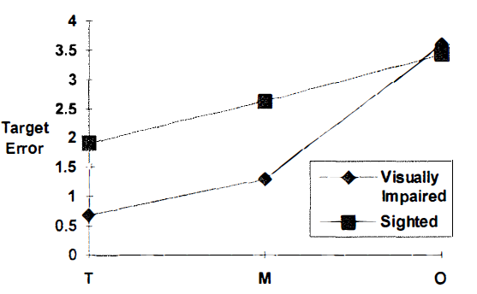
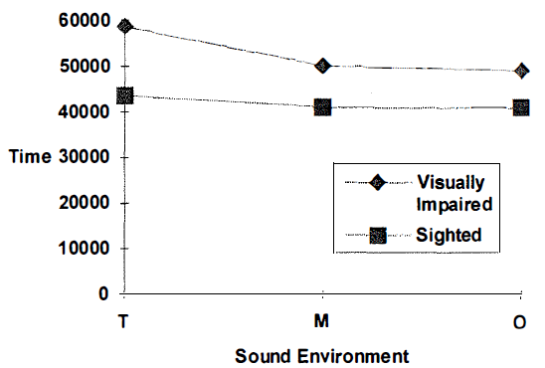
RESULTS
TARGET ERROR VS SOUND
But when visual clues were removed significant changes were noticed
In addition to more target errors, the sighted users also took longer with this sound-only scenario than when they had both visual and audio cues.
In the subjective preference visually impaired users preferred tonal environment and sighted users preferred the musical environment.
.
TIME VS SOUND

Slide 12
DISCUSSION
Sound can be used as a metaphor for visually impaired users in a 3D application
while testing in only sound environment visually impaired users perform better as they have more developed sense of hearing.
When discussing the things subjectively sighted users rely heavily on sights and take little help from audio metaphors where as impaired user heavily relies on the sound so tonal music was preferred as it was more accurate and least distracting.

Slide 13
LIMITATIONS
The orchestral sound was expected to perform better but it was not because of
[1] Limited Resolution
The grid only contained 8 instruments and this has to be determined by relative volumes of adjacent orchestral sections. Thus lacking resolution between grid is a major problem
[2] Unfamiliarity
Users were less familiar with the orchestral grid but when the study tested it for a week on Monday, Wednesday and Friday. The performance of the users improved.
TAKE AWAY
the possibility of sighted users operating 3D interfaces in situations where their attention needs to be focussed elsewhere, and opens the world of 3D interfaces to blind users

Slide 14
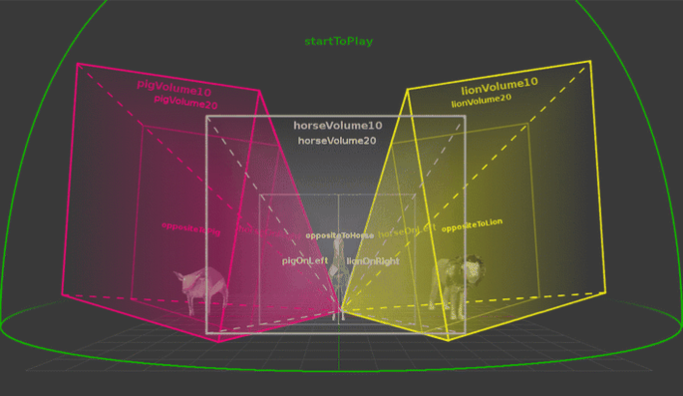
KEY IDEAS RELATED TO COURSE TOPICS
Narrowing gulf of execution and evaluation for both visually impaired and regular users.
Incorporating audio metaphors in designing applications will improve user experience for both blind and regular users.
Sound can be used as a medium for depth perception in a 3d application.
Applications in today’s world
virtualization of molded audio
PUBG mobile game
Used by coke to detect malfunctioning in bottle capper machine

Slide 15
PAPER 2
An Activity Centered Approach to Nonvisual Computer Interaction AUTHORS: MARK S. BALDWIN [University of California]
BONNIE NARDI [University of California]
GILLIAN HAYES [University of California]
JENNIFER MANKOFF [University of Washington]
Collaboration:
Empowertech is a LA based NGO devoted to bringing assistive technology to children and adult with disabilities
https://www.empowertech.org/index.php

Slide 16
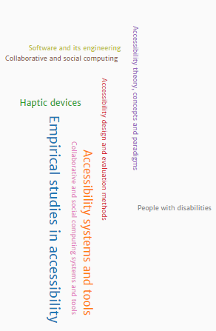
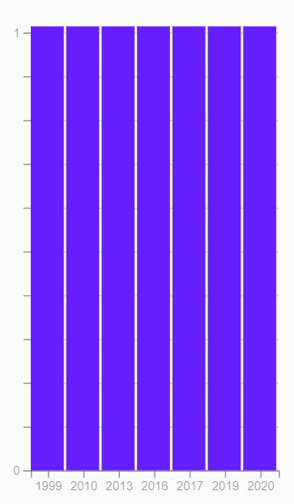
AUTHORS
MARK S. BALDWIN
PUBLISHED ITEM BY YEARS

Slide 17
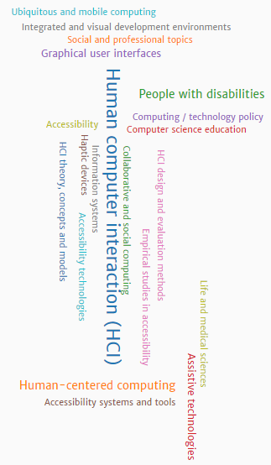
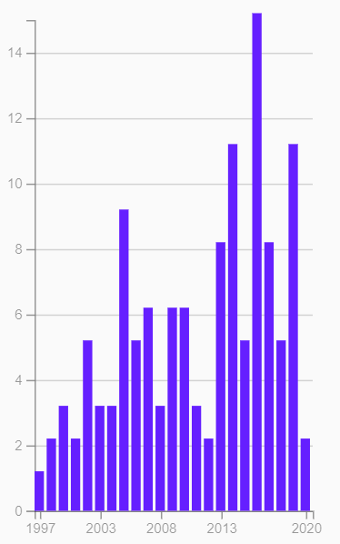
AUTHORS
BONNIE NARDI
PUBLISHED ITEM BY YEARS

Slide 18
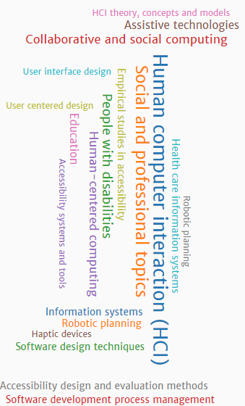
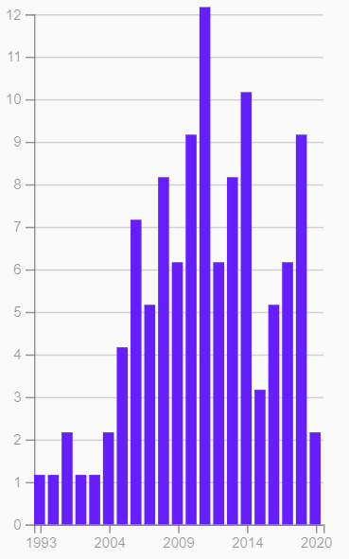
AUTHORS
GILLIAN HAYES
PUBLISHED ITEM BY YEARS

Slide 19
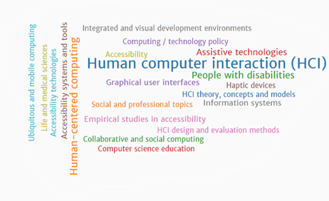
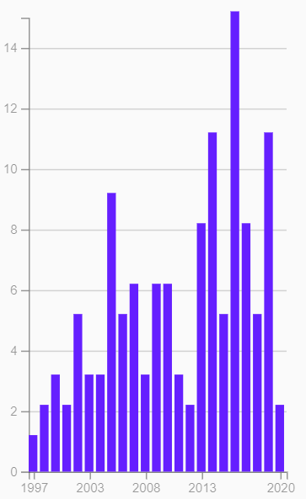
AUTHORS
JENNIFER MANKOFF
PUBLISHED ITEM BY YEARS

Slide 20
ABSTRACT
The aim of this paper is to provide design principles that a designer should consider when designing a tool for non visual interaction.
Despite ground breaking development in the screen readers, screen magnifiers, and other technologies, non-visual computing for blind users and those with limited vision continues to lag behind visual computing in usability and advanced functionality .
This paper provides a new approach structured around human activity to overcome obstacles for low vision or blind users face when interacting with GUI.

Slide 21
HCI KEY WORDS
Empirical studies in accessibility
Human-centered computing → Haptic devices
Social and professional topics
Accessibility
HCI design and evaluation methods
Activity theory and activity based computing
Assistive Technology
Collaborating and social computing

Slide 22
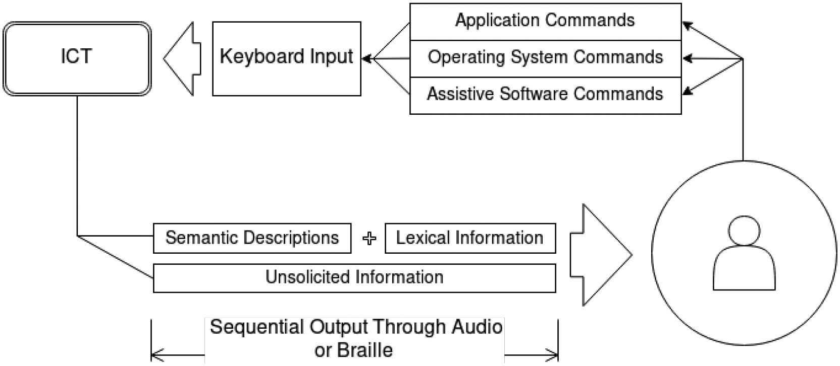
Background
The typical workflow for non-visual use of computational systems. A blind or low vision user must recall application, operating system, and assistive software keyboard commands to control input into an Information and Communications Technology (ICT). The ICT responds to keyboard input through a serial stream of auditory information that combines semantic and lexical information.

Slide 23
Background
Blind and low vision users must rely on a keyboard for input and specialized software for converting visual and textual information to speech or a magnified viewport.
As more information is presented visually,
This approach widens the gap for blind and low-vision users between the human activity and the technological abstraction, as all of the services and data typically communicated visually.
The goal here is to center the accessible technologies for the desktop computing environment from the ground up as an infrastructure centred around activity.
There are two advantages of this approach
[1] Simple Abstraction increases accessibility and removes overhead that limit adoption of activity centered design.
[2] By rearticulating the preferences of blind users we think about assistive technologies.
The transition from command line to graphical interface signalled a turning point for individuals who were unable to manipulate a WIMP (windows, icons, menus, and pointers) environment.

Slide 24
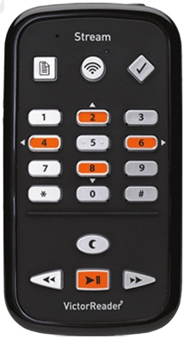
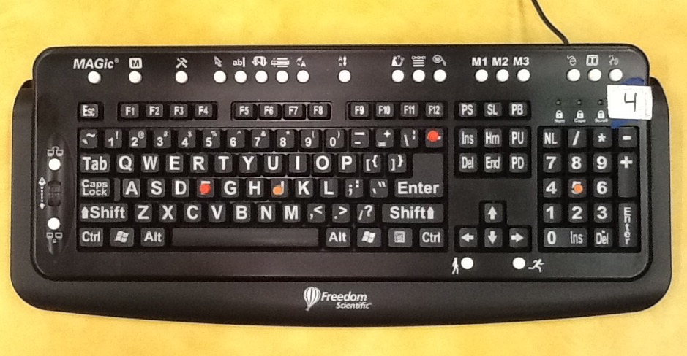
Current assistive technologies

Slide 25
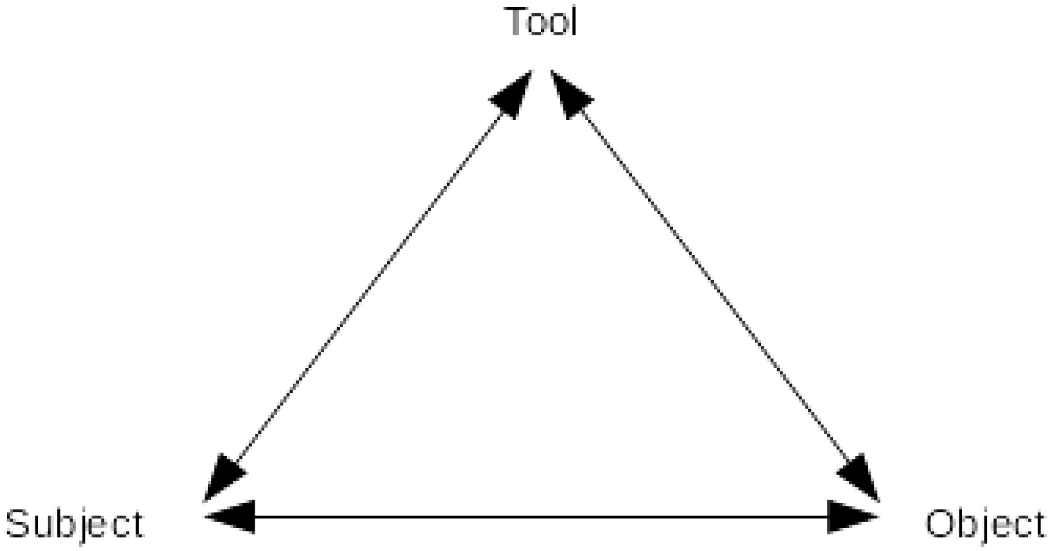
RELATED WORK
Accessible system
It focus on development of subsystem that understood how to pair metadata with interface element thus it becomes natural component of user interface.
The transitory nature of audio cannot allow audio to be used as metaphors in certain applications
So focusing on tangible system on which human can interact with increases their recall abilities.
Activity Theory
Activity theory describes a conceptual framework for understanding the goals, motives, and needs of human consciousness. Activity can be describe as a relationship between the human subject and an object, traditionally denoted symbolically as S → O.

Slide 26
STUDY
To understand the challenges and opportunities of non-visual computing a study was undertaken with empowertech. The aim is understand the unconscious operation being conducted in the service of the task. The analysis indicate that
[1] activity centric approach will be supportive of non-visual users.
[2] challenges of shifting from application centric to activity centric
[3] multi-model and tangible solution that can address the need of users.
Through activity theory lens we observe the relationship between actions that human consciously perform and operations that human unconsciously perform.
Challenges that occurred with users
[1] non-visual users often struggle to structure their data and services by activity.
[2] resuming and pausing events is a challenge.
[3] lack of visual feedback makes user to query and cycle through service making system opaque.
[4] The challenges of organization of data, services, and applications for non-visual users within a
single activity indicate that existing computational abstractions are not sufficient for blind and low vision users.

Slide 27
STUDY
An activity theoretic approach to accessibility
[1] Organization by activity
[2] Activity tracking
[3] Operationalizing Actions

Slide 28
DISCUSSION
The idea of seeing the tool we are using becomes natural part of interaction frames is our goal.
Framing nonvisual interaction by activity provides a mechanism by which we can raise the quality of the interaction of nonvisual digital objects to that of the cane, and operationalize interactions for blind users.
Designers who restructure their interactions around the notion of activity can improve the
potential for unconscious operations to emerge with time for non-visual users.
considerations designers must engage to merge non-visual computing with the more
natural orientation of human activity.
Tasks Vary by Activity, Interaction, and Ability
Make Change a First Class Citizen
Design for goals not applications

Slide 29
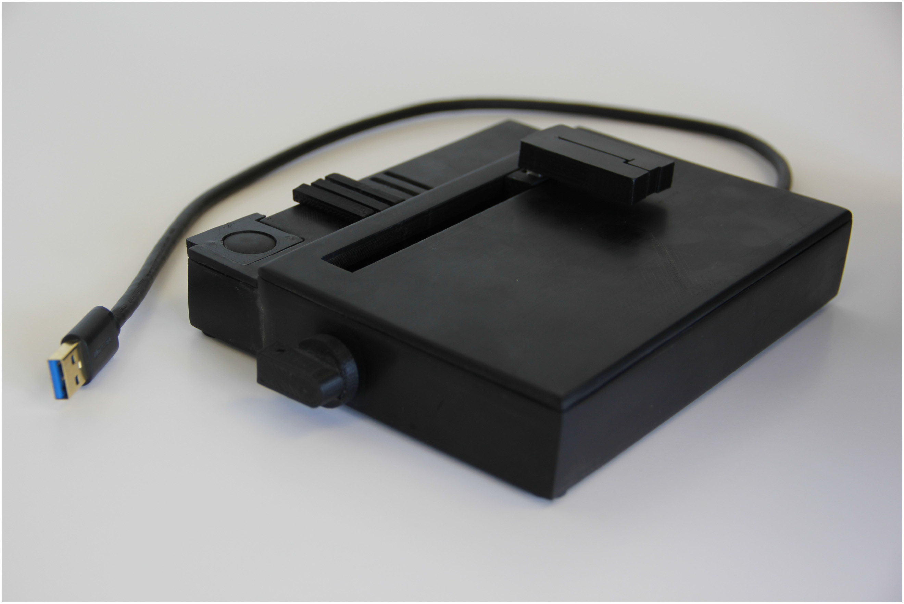
DISCUSSION
Kinesthetic Interaction Device (KInD)
To apply activity theatrical consideration an API was developed on top of Google drive cloud management fie system. This API was controlled either by Command line or by KInD.
KInD makes use of three physical interactions that enable users to accomplish their goals non-visually.
The KlnD represent activities through tactilely differentiated tangible tokens. It also tracks systematic changes making easy for user to move between the task easier. Finally, KInD implements tangible spatial structure to encourage operationalization through proprioceptive memory rather than auditory seeking.The physical interactions are as follows:
[1] activity management [2] Interaction History
[3] Contextual Change [4] Virtual Docks

Slide 30
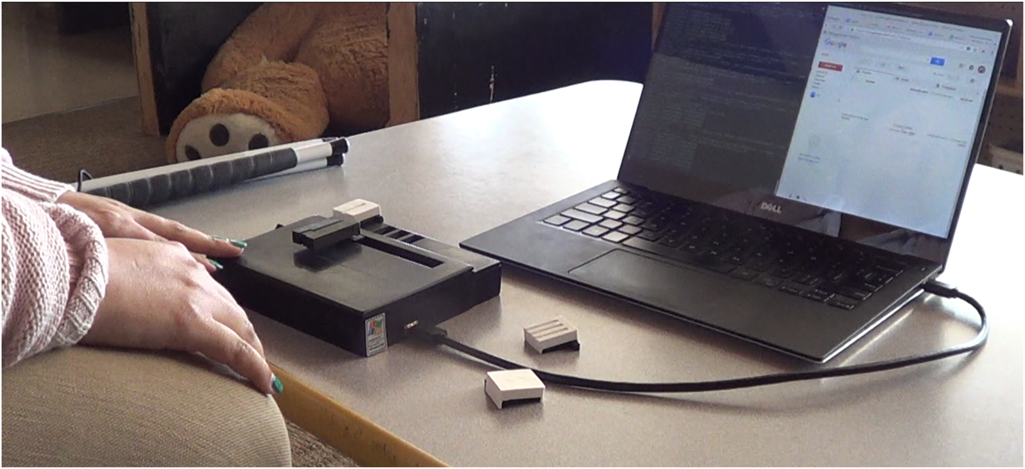
DISCUSSION
Kinesthetic Interaction Device (KInD)
Mapping KinD and API to design consideration
[1] Modeling Interactions on Need
[2] Supporting System Change
[3] Supporting User Goals
An example of the setup used during design sessions with KInD

Slide 31
Limitations and future work
Despite new ways of approaching the problem to reduce the barrier for blind users the research has some limitations
[1] The results were mostly based from the study of data for novice computer users. But a separate study has indicated and few expert users that have taken part in the research faced similar challenges.
[2] The future work for this research is to develop more assistive tools and API that support operationalizing routine computer interactions.

Slide 32
Comparison and views
PAPER 1 | PAPER 2
The research idea was fairly simple but innovative for the time period | The research Idea was not to follow traditional form and find the new ways of non-visual interaction.
They tried to implement sound metaphors in 3D GUI | They approached the problem based on activity theory
Work around the problem | Worked at the root cause of the problem
The research was used to understand sound perception in many applications | They invented the haptic device of their own based on activity theory.
The results were different than expected by researchers | Researchers managed to explore their ideas and successfully demonstrate their ideas

Slide 33
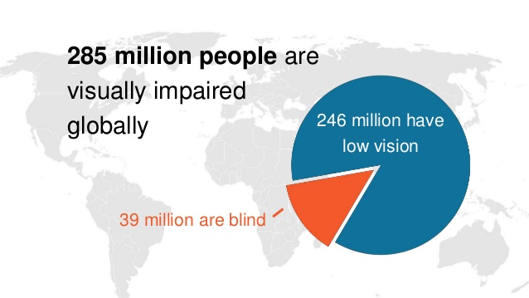
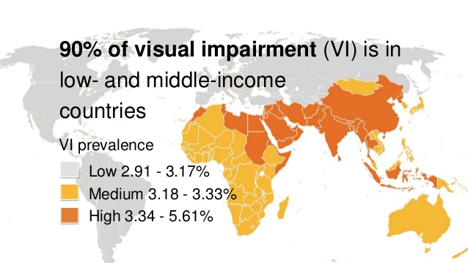
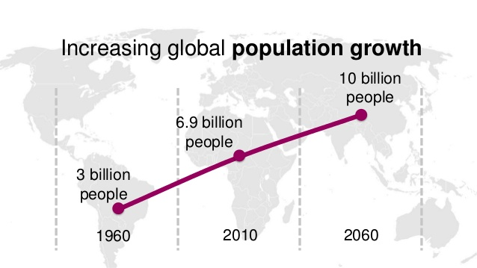
Societal Impacts
Based on study undertaken by international center for eye health and London school of hygiene
There are substantial obstacles towards reaching employment for those with visual impairment. Based on survey done by researchers.
In a survey of over one thousand blind and visually impaired adults, researchers found that less than 40% of surveyed participants were employed.

Slide 34
REFERENCE
https://dl.acm.org/profile/81464657202
https://dl.acm.org/profile/81100391310
https://dl.acm.org/profile/81100110886
https://link.springer.com/article/10.1007/s10055-015-0274-4
https://www.slideshare.net/InternationalCentreforEyeHealth/epidemiology-andvisualimpairment

Slide 35
THANK YOU
QUESTIONS ?

